Slide 1
Best Practices of strong and effective governing boards
14 MARCH, 2011
AFRICA NAZARENE UNIVERSITY
Board of Trust and University Council

Slide 2
The GOAL …
to review strategically the roles and responsibilities of the ANU Board, affirm Board “best practices, ” and identify the goals and action steps necessary for the Board to lead the school successfully into the next phrase of university life.

Slide 3
Who are
the Board of Trust,
University Council , and
University Senate,
and what do they do?

Slide 4
What is a
“governing”
board?

Slide 5
Definitions
(www.thefreedictionary.com)
Noun
1. governing board - a board that manages the affairs of an institution
2. board of trustees - a governing board elected or appointed to direct the policies of an educational institution
3. regent, trustee - members of a governing board

Slide 6
Working Assumption:
Strong governing boards
enable great leaders.
Outstanding leaders
embrace engaged boards.

Slide 7
Characteristic #1
Board members
understand the role,
purpose and function
of the board,
including board structure

Slide 8
HEAD IN – FINGERS OUT
Best Practices:

Slide 9
Is there one governing board of Africa Nazarene University?
If so, what does the board do?
If more, how do they relate to one another?

Slide 10
Effective Governing Boards …
focus on policy formation
and mission strategy;
not policy implementation
and daily operations.

Slide 11
1a. Three modes of university governance.
Fiduciary mode:
Steward of tangible assets.
Develop universities policies, values, and priorities.
Deploy resources missionally and wisely.
Ensure legal and financial integrity.
Approve academic programs consistent with university mission, vision, and values.
Steward of long-term health and mission accomplishment of the university.

Slide 12
Strategic mode:
Planning partner with the vice-chancellor
Drafts, updates, and reviews the mission
and strategic planning documents in light
of the mission of the university.
Proactive and intentional in strategic
planning for mission and vision fulfillment.
Ensure that a strategic plan is in place.

Slide 13
Representative mode:
Comments and questions are rooted in ANU’s values, traditions, and beliefs. Problems are framed taking into account the heritage of the university.
“How is the ANU ethos communicated through academic programs?” “Do our decisions violate the values of ‘our’ university?”

Slide 14
1b. Who has governance and coordinating responsibility:
ANU financial health
ANU academic integrity
ANU spiritual well being
of students
of employees
(in consultation with national, regional, and global church leadership, as appropriate).

Slide 15
1c. Board – university vice-chancellor relationship
The Board selects the university vice-chancellor to implement the mission of the school on behalf of the Board…
The vice-chancellor is the ‘eyes, ears, hands,
and feet’ of the Board between
board meetings.

Slide 16
1d. Board committees and agenda development
Effective Boards have functioning executive committees and other appropriate committees for effective decision making.
Board agendas are developed to insure balance between leadership reports and time to deal with long term direction and progress.

Slide 17
Characteristic #2
Board members
know, communicate, and
make decisions
in light of the university’s
mission, vision and values.

Slide 18
MISSION AND VALUES DRIVE US
Best Practices:

Slide 19
ANU Mission:

Slide 20
ANU vision:

Slide 21
ANU values:

Slide 22
Realizing Our Intentions
“Always, the key question to be asked in Board decision making is:
Is this decision important for the long term survival, health, and mission achievement of our institution?
After answering this question, then policies and decisions can be made.”
Albert J. Meyer, author. p. 217

Slide 23
Characteristic #3
Board members
ask the
right questions

Slide 24
THINK QUESTIONS
Best Practices:

Slide 25
Board Members Ask The Right Questions (value defining and forward thinking…)
Who are we?
Where are we?
Where are we going?
How will we get there?
Why is it important to get there?
How will we know when we get there?

Slide 26
Basic on-going questions for ANU Board and university leadership:
Why did our constituents want to have this university in the first place?
Why does this university exist in 2011?
Is this decision important for the long term survival, health and mission achievement of our institution?

Slide 27
Does your school have a mission statement that is known, owned, and repeated?
Have you marshaled the resources to fulfill the mission?
Are you accomplishing your mission?
Are you going to marshal the resources to continue fulfilling your mission?

Slide 28
Additional Board questions:
What should we be worrying about as a school?
What are we hearing that the school administration needs to hear?
What are we thinking or dreaming about the school?
What are our concerns about school?
What can the districts, churches, and institution do to better accomplish the mission of the school?

Slide 29
Characteristic #4
Board members
understand and embrace
a Board Policy Manual that contains the Board approved policies for effective and efficient governance of organization.

Slide 30
WRITE IT DOWN
Best Practices:

Slide 31
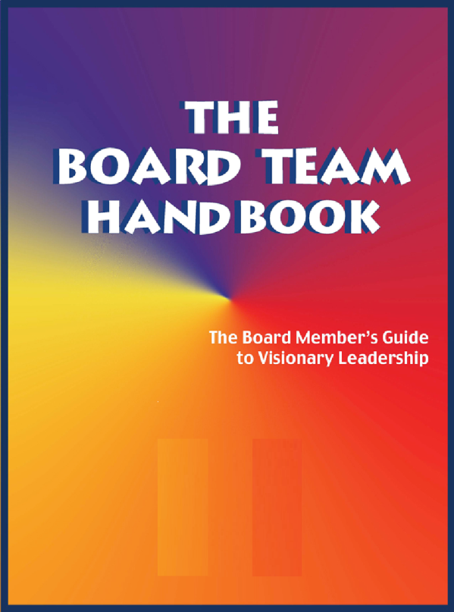
Board members understand and embrace a Board Policy Manual
that contains
the Board approved policies
for effective and efficient governance of the
university.

Slide 32
Board policies and procedures
are maintained in a notebook
that is provided for every
board member and updated
after each board meeting.

Slide 33
TEMPLATE
AMBROSE UNIVERSITY COLLEGE
2010
Board Manual
A forward looking, value-defining, and facilitating Board
Introduction
This Board Standing Policies Manual contains all the standing, or on-going, policies adopted by the Board of Trustees.
Reasons for Adoption. The reasons for adopting this evolving manual include:
1. Efficiency of having ALL on-going board policies in one place.
2. Ability to quickly orient new board members to current policies.
3. Elimination of redundant, or conflicting, policies over time.
4. Ease of reviewing current policy when considering new issues.
5. Clear, pro-active policies to guide the college president.
6. Models an approach to governance that sister institutions
may use

Slide 34
I. Organizational Ends toward which we are working—Mission, Vision, Values
This section defines why we exist, for whom we exist, what we intend to contribute to those for whom we exist, and the priorities we assign to the benefits we provide to them.
II. Board Governance Process
This section defines how the Board will go about doing its work of governing the organization.
III. Board/President Relationship
This section defines how the Board will delegate authority and responsibility to the president.
IV. Executive Parameters
This section defines the parameters/limitations within which the president will work in accomplishing the task assigned to him/her.
*Based on writings of John Carver on Board Governance

Slide 35
Characteristic #5
Board members
communicate
with each other and
address conflict situations
as Christians.

Slide 36
WATCH YOUR WORDS
Best Practices:

Slide 37
Board members communicate
with each other Christianly (Eph. 4:2), compassionately,
respectfully,
directly,
and supportively.

Slide 38
A good university leader and board chair relationship is like a good marriage: it is based on mutual respect, trust, commitment, and effective communication.
Board members relate to the university vice-chancellor and the constituency with one voice.
The university constituency desires and expects a synergistic board and vice-chancellor partnership.

Slide 39
Vigorously discuss policy options and make decisions within the board meetings,
And communicate board action outside the board
meetings with
unified support.

Slide 40
Characteristic #6
Board members listen to the constituency, appreciate the heritage of the school, and model faith development and spiritual formation.

Slide 41
Active not passive representation of the university
Best Practices:

Slide 42
Character Counts
Speak Gracefully.
Live Gratefully.
Listen Intently.
Forgive Freely.
Lead Decisively.
Care Deeply.
Pray Earnestly.

Slide 43
Characteristic #7
Board members
intentionally engage in
mutual accountability,
including systematic
board development and
evaluation.

Slide 44
INTEGRITY MATTERS
Best Practices:

Slide 45
Board Development Questions:
How does the work of the board support the overarching mission and vision of the university?
In what ways have the initiatives of the board contributed to the numerical growth and spiritual development of the university?
How can the climate of collaboration between the board, council, senate and school leaders be enhanced?
What are the three top institutional challenges for the next year? What short-term and long-term goals have been established in light of these challenges?
Are the board’s short-term and long-term goals aligned with the institution’s strategic plan?

Slide 46
Characteristic #8
Board members
take time to
process decisions and
adhere to the practice of
“no surprises”

Slide 47
TAKE TIME
Best Practices:

Slide 48
The Board leadership and school leadership work together to plan, set agendas, and develop policy recommendations to the Board.
The ANU vice-chancellor is involved in any board development process, and the board chair is kept abreast of major developments in the university.

Slide 49
Characteristic #9
Board members
embrace change and resolve
to work through transitions
together and united for
the good of the Kingdom and the advancement of God’s mission

Slide 50
YES! TO VISION-INSPIRED CHANGE
Best Practices:

Slide 51
Characteristic #10
Board members
participate in assessing
the effectiveness of prior decisions and collectively make appropriate adjustments.

Slide 52
REVIEW - REVISE - RESTATE - RENEW
Best Practices:

Slide 53
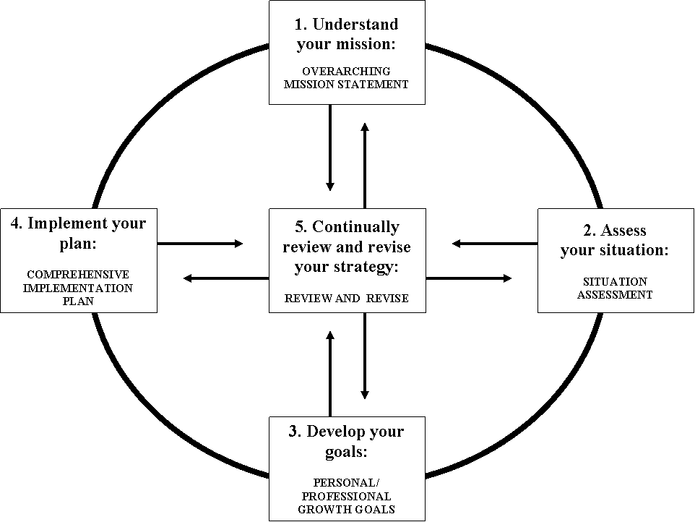
Planning Cycle

Slide 54
Characteristic #11
Board members
are outstanding examples
of giving regularly and sacrificially to the church and the university.

Slide 55
ROLE MODELS OF GENEROSITY
Best Practices:

Slide 56
Financial donors look first
to board members for evidence
of their consistent giving
to the university
-individually and collectively

Slide 57
Characteristic #12
Board members
develop new leaders
for increased responsibilities and commitment
to the organization.

Slide 58
PASS IT ON
Best Practices:

Slide 59
Board members develop
new leaders
throughout the region
for increased responsibilities
and commitment to
Africa Nazarene University.

Slide 60
Reproduce yourself
as a passionate advocate
for the university.

Slide 61
Use committees as a way to provide opportunities for emerging leaders to take on more responsibility.
Board leaders should intentionally mentor and nurture the next generation of leadership for ANU!

Slide 62
Key questions to be pursued:
In Summary

Slide 63
Critical Issues identified on day one of Board workshop:
Board-owned vision for ANU’s future
Survival in competitive education environment (inc. on-line education)
3. Plans and procedures for making tough decisions (inc. scenario planning)
Protocols and systems for elections
Succession planning for the Board, senior administration, and faculty
Clergy-laity balance on Board (inc. representation of ANU constituency)
Impact of SANU on ANU Board representation
Need for Board Policy Manual (articulate relationship of Board of Trust and University Council)
Are both (BofT and UC) still needed in light of Charter Section15 (1)?
Maintaining stability while implementing change

Slide 64
Identify the top 5 critical issues that facing ANU in the next 3 years as the institution plans for the future

Slide 65
Next steps:

